Slide 1
Carbohydrate Metabolism:
Gluconeogenesis
INTER 111: Graduate Biochemistry

Slide 2
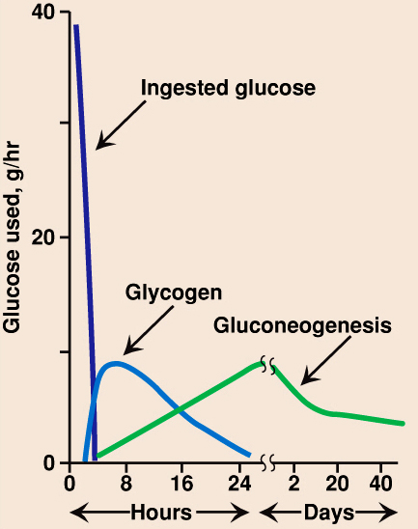
Carbohydrate metabolism upon fasting
‘average’ 8 hr sleep
‘average’ 12 hour fast
Gluconeogenesis is also major component of normal metabolism -
in sleep, 35-70%
blood glucose supplied by gluconeogenesis

Slide 3
PEPCK is thought to be essential in glucose homeostasis, as evidenced by laboratory mice that contracted diabetes mellitus type 2 as a result of the overexpression of PEPCK.
Burgess et al. (2007) Cytosolic phosphenolpyuvate carboxykinase does not solely control the rate of hepatic gluconeogenesis in the intact mouse liver. Cell Metabolism 5(4), 313-320.

Slide 4
Mighty mice: PEPCK expressed in skeletal muscle

Slide 5
Carbohydrate Metabolism:
Glycogen
INTER 111: Graduate Biochemistry

Slide 6
Glycogen metabolism: learning objectives
Know the general structure of glycogen. Be able to write the chemical structure of a segment of glycogen showing the two types of glycosidic bonds. Understand why 2 kinds of glycosidic bonds give a branched polymer. Be able to identify the ‘reducing’ vs ‘non-reducing’ ends.
Understand that glycogen breakdown requires two enzymes. A phosphorylase cleaves the (α-1,4) bonds at the non-reducing ends, adding the elements of orthophosphate (PO3²⁻ or P_{i}) to give glucose-1-phosphate. A ‘debranching’ enzyme cleaves the (α-1,6) glycosidic bonds. Be able to write down these reactions.
Understand that free glucose is obtained by the enzymatic conversions: glucose-1-phosphate →glucose-6-phosphate →glucose. Know the structure of glucose-1-phosphate.
Be able to recognize the structure of UDP-glucose. Understand that glycogen synthesis is initiated by glycogen synthase which adds UDP-glucose to the nonreducing end of a growing chain.
Regarding cyclic AMP, know (i) its structure, (ii) its synthesis and the enzyme involves, and (iii) how its cellular levels are regulated.

Slide 7
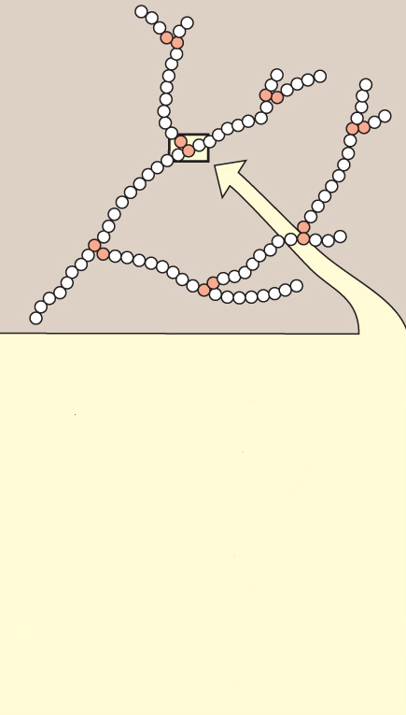
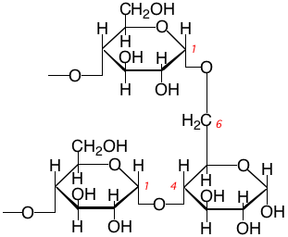
Chemical structure of glycogen
glycogen
Branched chain homopolysaccharide, exclusively made of α-D-glucose

Slide 8
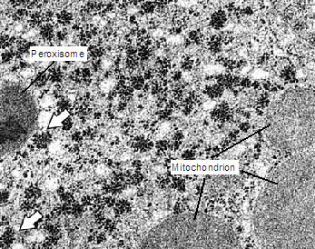
Electron micrograph of liver cell shows glycogen deposits in the cytosol

Slide 9
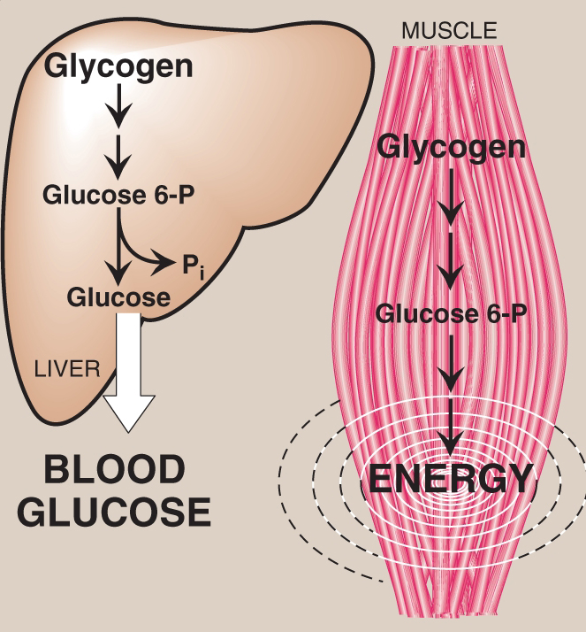
Main stores of glycogen are skeletal muscle and liver
Formation and breakdown of glycogen occurs in the cytosol
Liver glycogen - maintain blood glucose concentration
Muscle glycogen –
fuel reserve for ATP synthesis during
muscle contraction
100 g glycogen ~ 10% adult liver
400 g glycogen ~
1-2% fresh weight of resting muscle

Slide 10
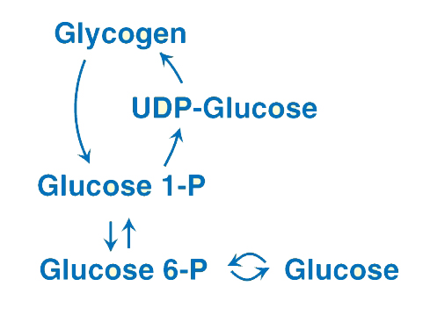
Metabolic pathways involving glycogen
Glycogen formation = glycogenesis
Glycogen breakdown = glycogenolysis

Slide 11
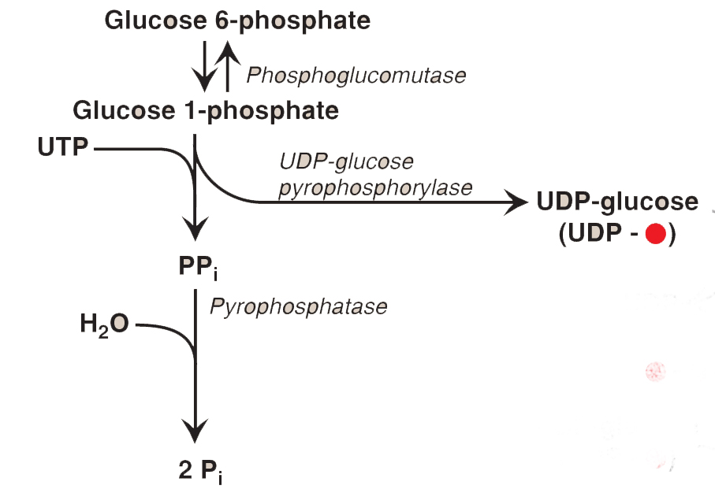
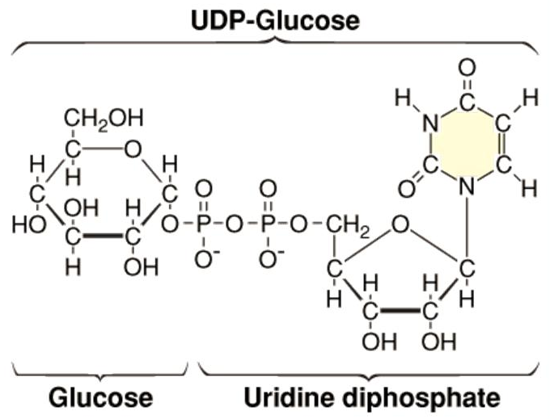
UDP-glucose synthesis is the first step in glycogenesis

Slide 12
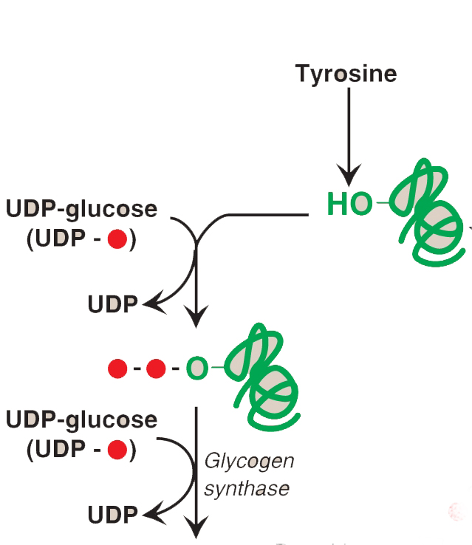
A primer is necessary to initiate glycogen synthesis
glycogenin
glycogen
synthase
Glycogen synthase makes α(1->4) linkages in glycogen

Slide 13
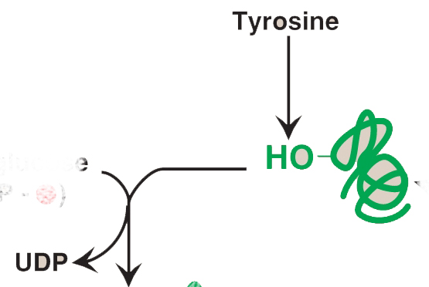
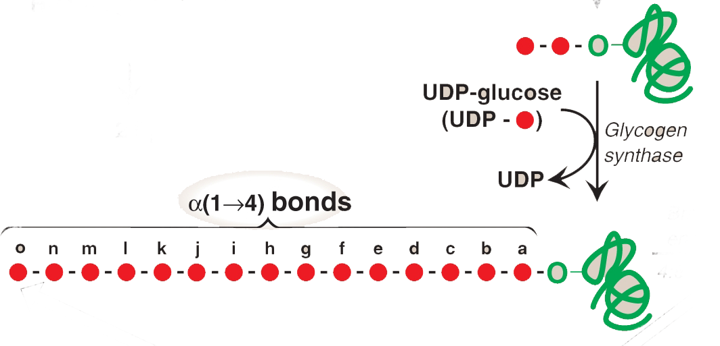
Glycogen synthase elongates glycogen chains
glycogenin
glycogen
synthase

Slide 14
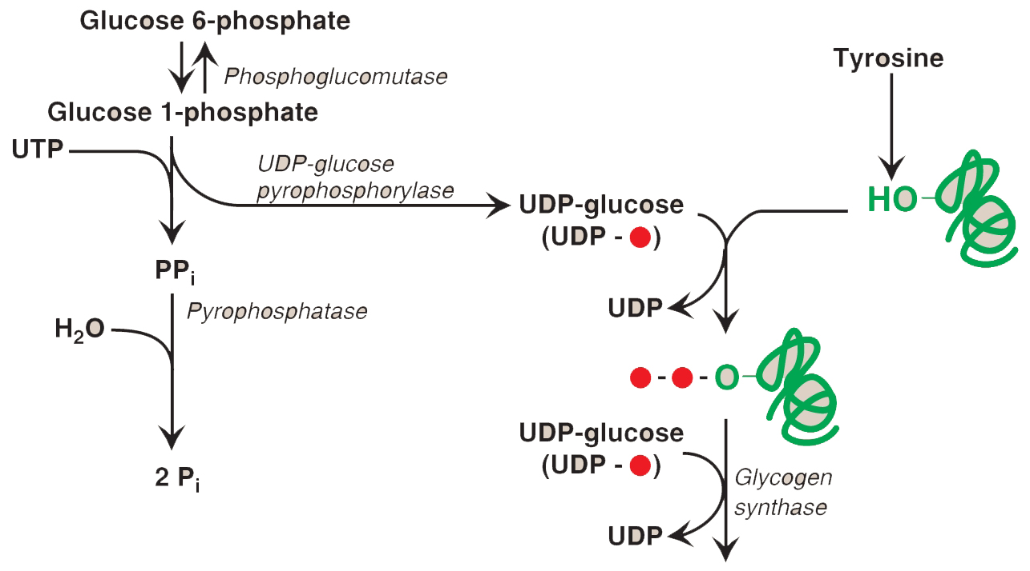
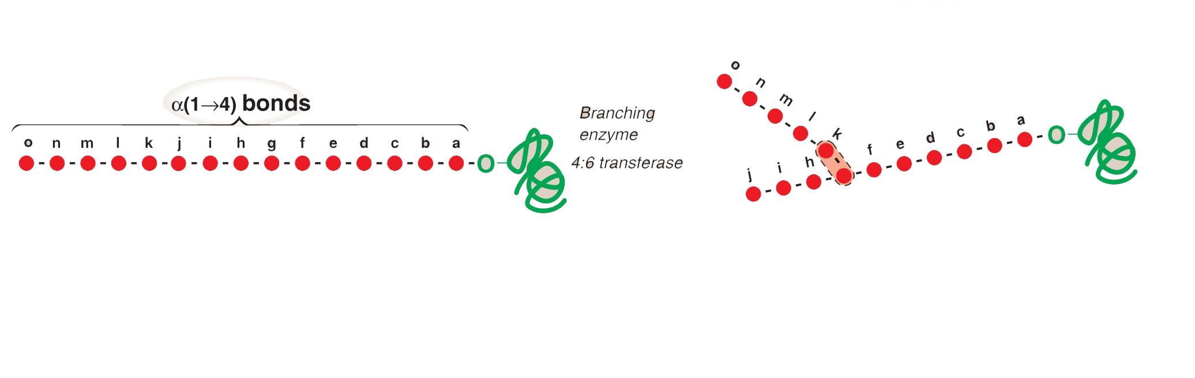
Glycogen has branches ~every
8 glucosyl units apart
α(1➔6)
bond
Branching enzyme [amylo-α(1->4)-α(1->6)-transglucosidase] transfers a
chain of 5-8 glucosyl units from a nonreducing glycogen end and attaching it
by an α(1->6) linkage.

Slide 15
Glycogen has branches ~every
8 glucosyl units apart
further elongation at the nonreducing ends by glycogen synthase
further branching
GLYCOGEN

Slide 16
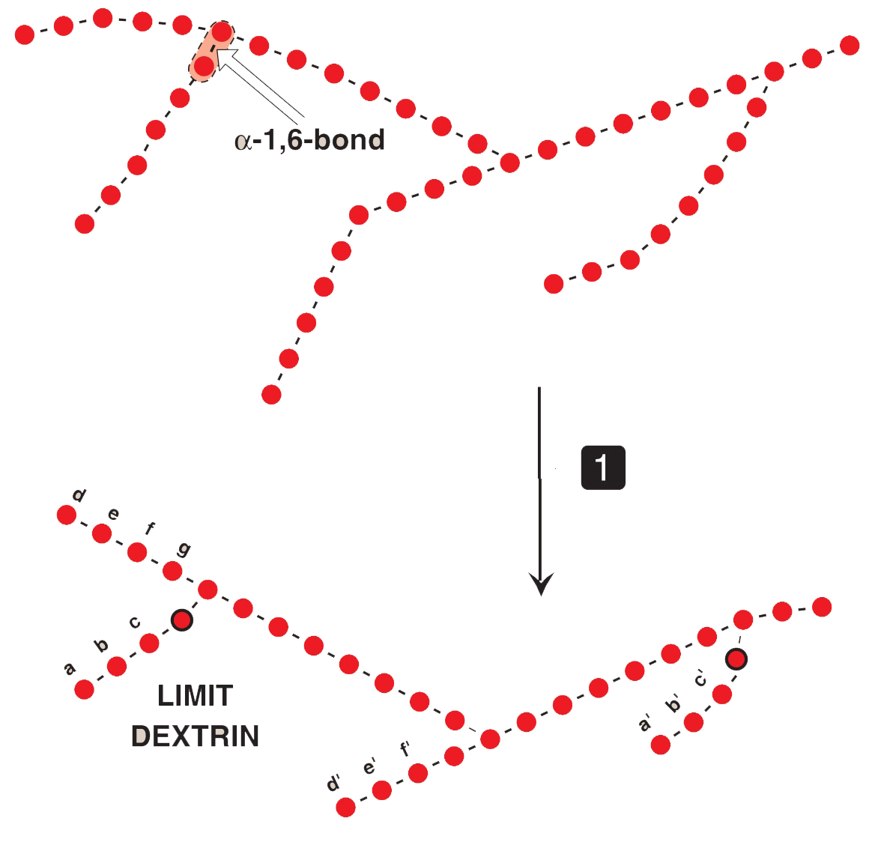
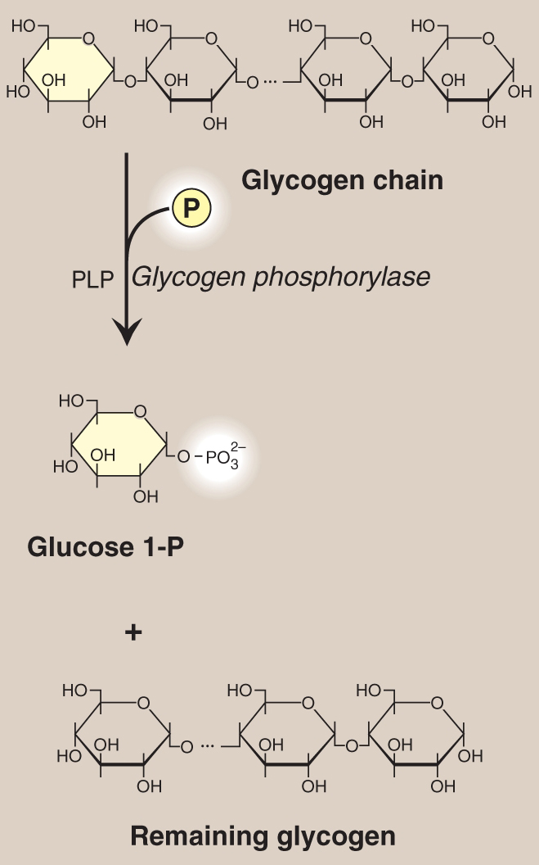
Initial step in glycogenolysis is chain shortening at the nonreducing ends
P_{i}
Glycogen
phosphorylase
Glucose 1-P

Slide 17
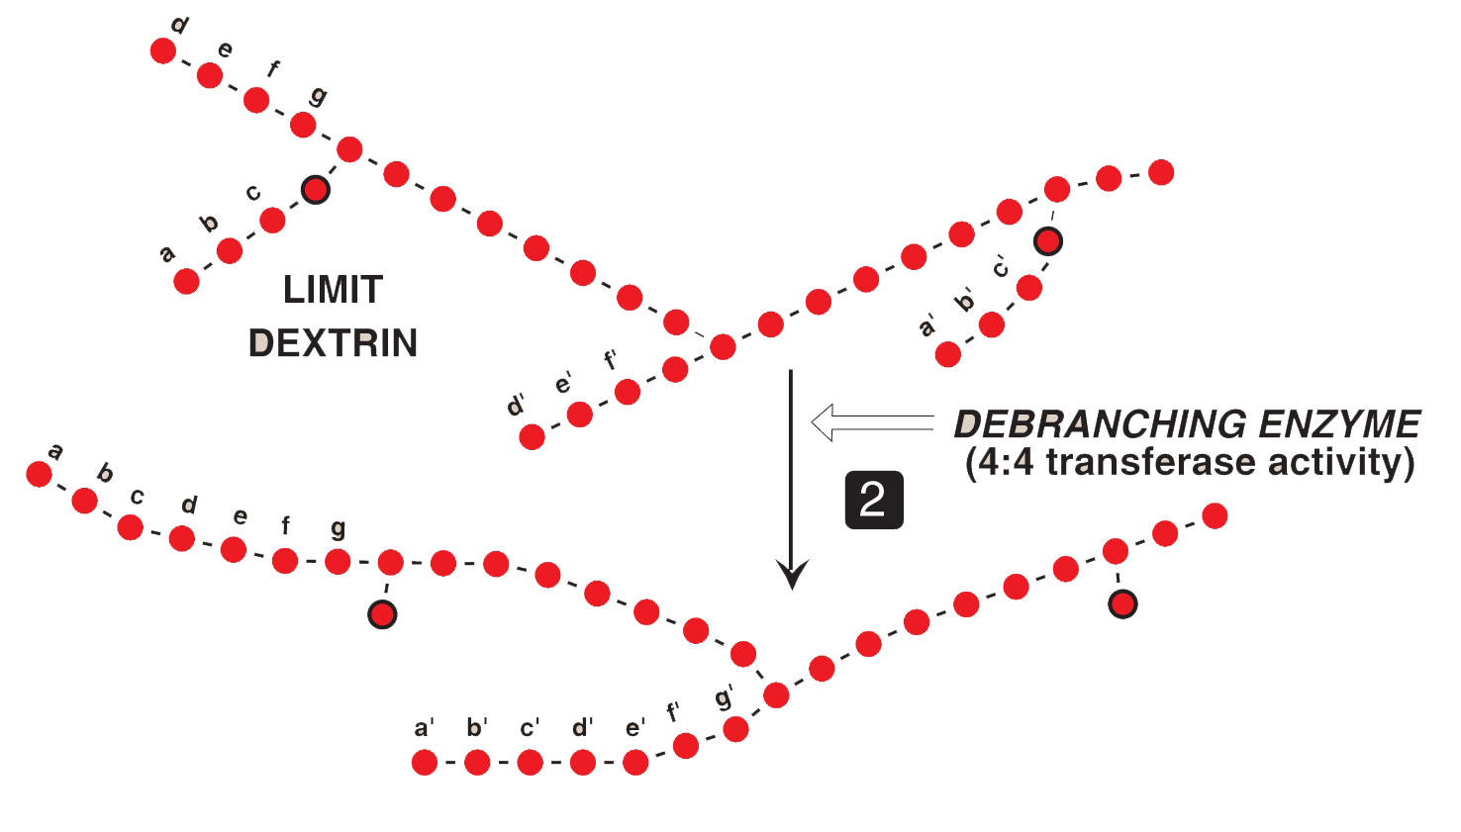
Branches are removed by two enzymatic activities of a single bifunctional protein
Oligo-α(1->4)-α(1->4) glucan transferase
removes outer 3 of the 4 glucosyl units on a branch &
transfers them to the nonreducing end of another chain

Slide 18
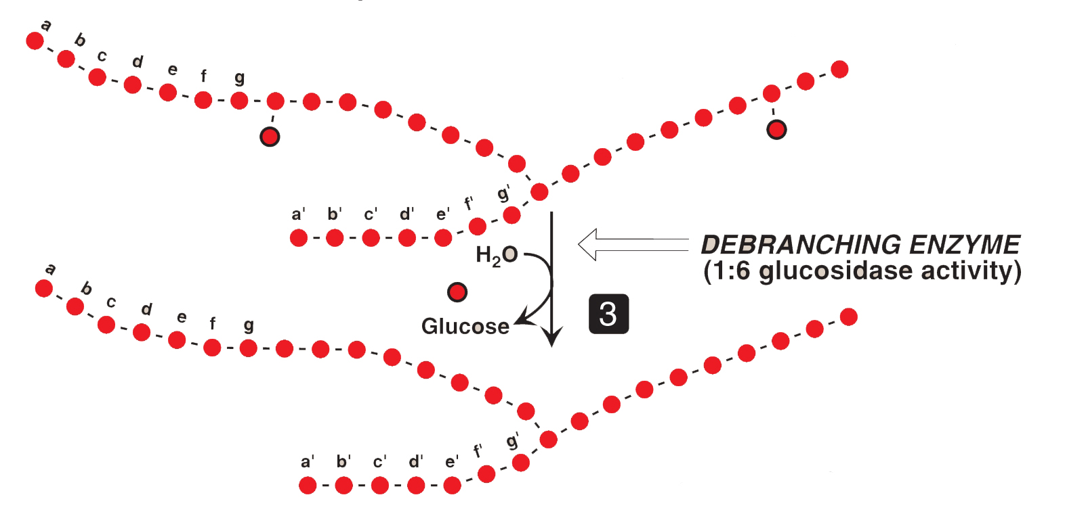
A second type of debranching enzyme participates in removing α(1 6) bonds
The remaining single glucose residue attached in an α(1->6) linkage is removed by amylo-α(1->6)-glucosidase.

Slide 19
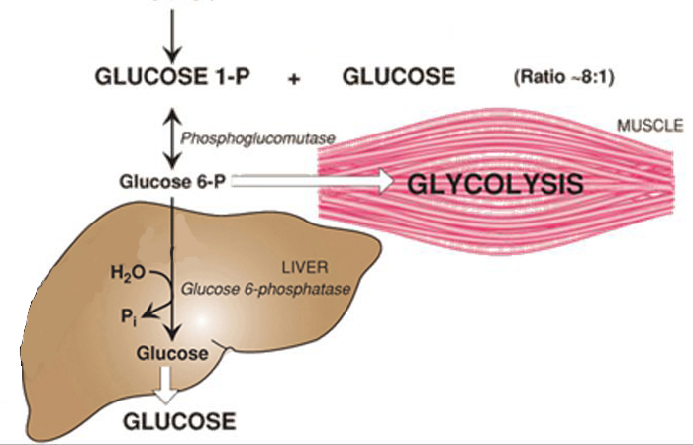
Glu 1-P from glycogen phosphorylase is converted to glu 6-P

Slide 20
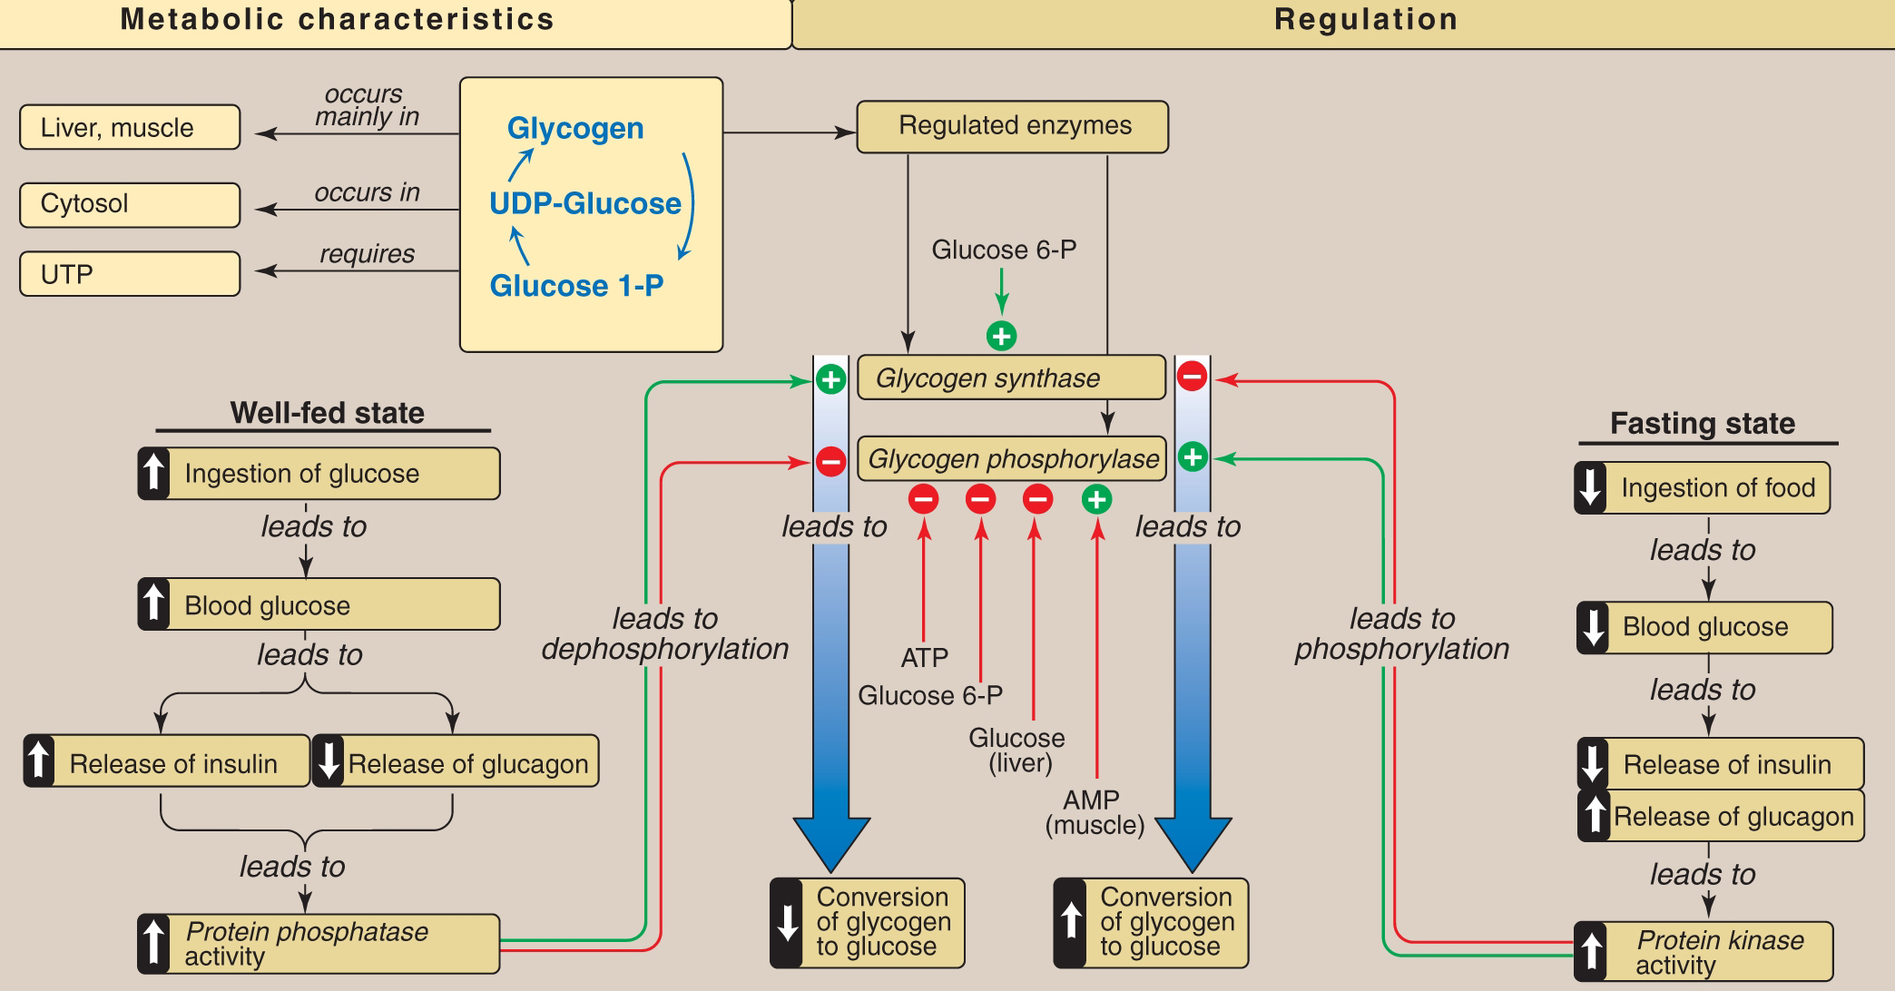
Concept map for glycogen metabolism in the liver

